Slide 1
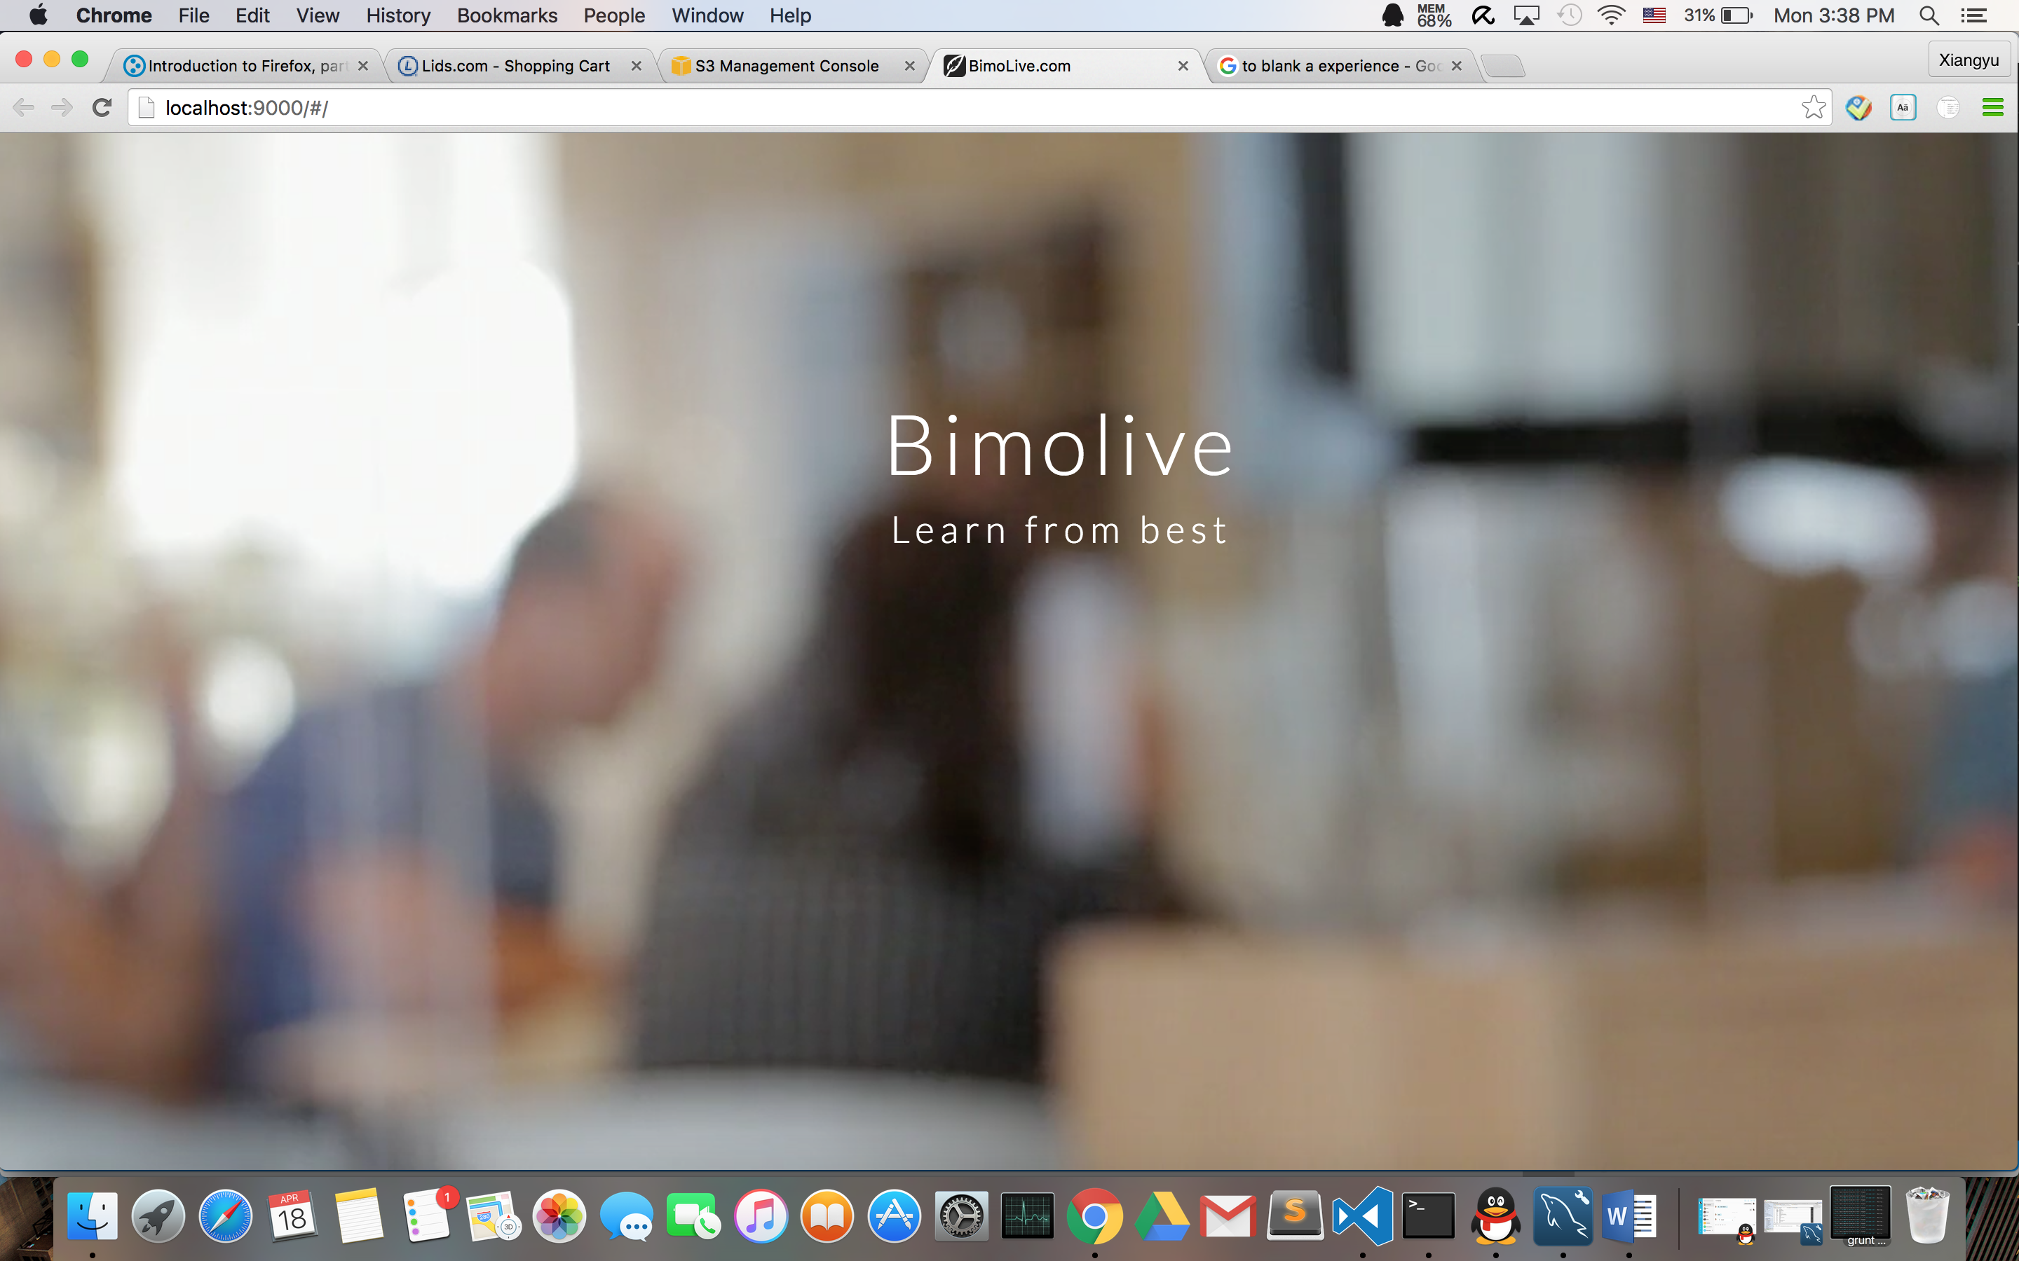




Bimolive.com is the first live streaming video platform for education ever. Users can live broadcast videos for others to watch. These videos can range from a college-level lecture to a simple guitar lesson. Bimolive.com provides awesome features that will make online learning an easy and fun experience.
Student
Watch live videos
Ask questions
View sent questions
Watch replay videos
Follow teacher and course
Search
Edit account
Apply to teach
Teacher
Create courses and lectures
Broadcast live videos
Add permission code
Add time tags
Answer questions
Ban students
Upload lecture videos
Back-End
Front-End
The PROs
Chonghuan Xia
Shengzi Hong
Xueyang Han
Xiangyu Zhong
BimoLive.com@gmail.com

